Slide 1

Yoga in Toronto
IBM Data Science Capstone
Alyssa Mendenhall
3/12/20

Slide 2
Problem: Yoga Studio Location
Yoga is highly beneficial for mental and physical well-being
Increasing numbers of individuals are becoming aware of this trend
Determining an ideal location for a yoga studio is difficult as there must be interest but not oversaturation
Opening a yoga studio is a significant investment (estimated $1 million CAD in Canada for all resources)^{[3]}, and as such, the location of the venue should be strategically planned

Slide 3
Solution: Yoga Studio Location
Explore yoga studio popularity in Toronto boroughs to find ideal location for an up and coming entrepreneur
Assumptions
Areas without yoga studios do not cultivate interest in yoga rather than lack of exposure
Areas with yoga studios as the most common venue have not filled their studios to capacity

Slide 4
Data Acquisition and Cleaning
Borough data acquired from Wikipedia^{[3]} using pandas
Longitude and Latitude data acquired from curated CSV
General Toronto location acquired using the Geocoding API
Venue Information acquired from Foursquare^{[2]}
One-hot transformations were applied in order to format the data for analysis using kMeans.
Please reference the associated Jupyter Notebook for a more thorough breakdown.

Slide 5
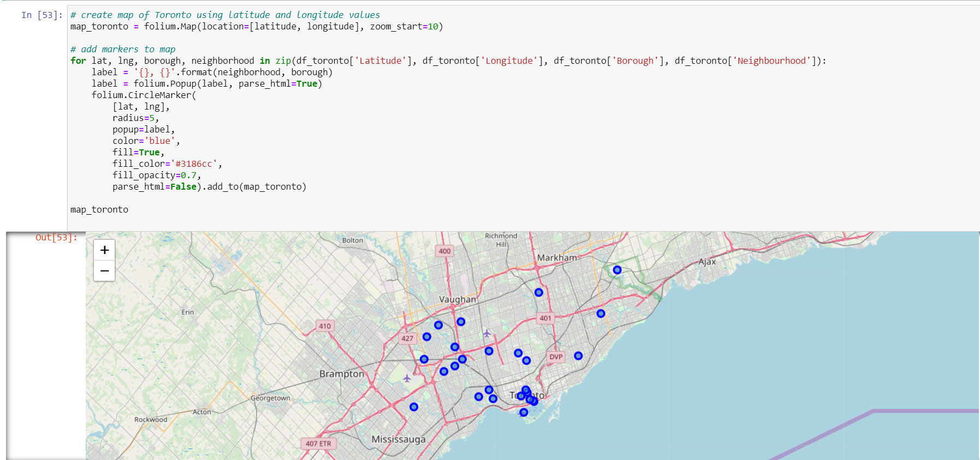
Data Acquisition and Cleaning
Longitude and Latitude data was visualized using Folium after acquisition as a check on the retrieval process

Slide 6
Cluster Analysis for Neighborhood Similarity
kMeans cluster analysis was performed due a variety of advantages
The data set is moderately sized, which is ideal for kMeans analysis
The algorithm is very efficient, allowing for optimization of the value of k with relatively time and computational power.
Although other algorithms may have given better results from exclusively specifying yoga studio as the only criteria for analysis, the use of kMeans allows for similarity of the neighborhoods in general to be compared, even if specific yoga studio data does not exist for a specific location.

Slide 7
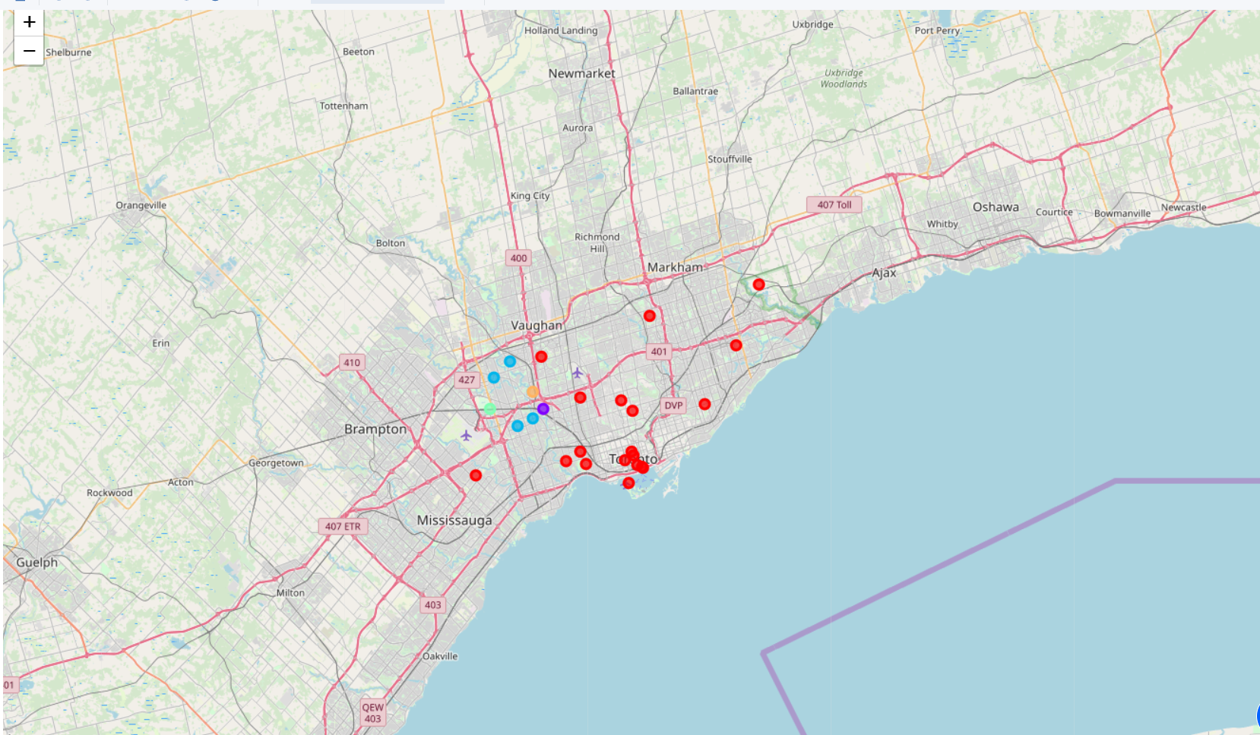
Visualizing Clusters
Clusters were visualized using folium to quickly see if geographic differences played a part in the clustering algorithm.

Slide 8
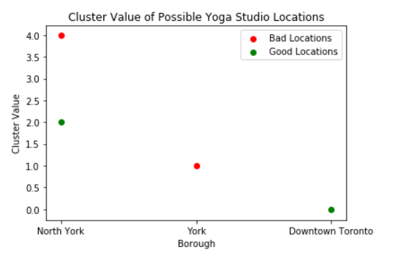
Result: Best Location for Yoga Studio Based on Popularity
When compared, clusters 0 and 2 produced boroughs with the most ideal locations. However, the overlap of neighborhoods in North York between ideal locations and non-ideal locations makes it a slightly more unfavorable choice.

Slide 9
Conclusions
The optimal location for a yoga studio would be in downtown Toronto.
If costs within Downtown Toronto are prohibitive, the kMeans cluster analysis gives other locations with similar predicted aspects. According to this analysis, another location in cluster 0 should be considered if other factors such as cost of real estate drive down the feasibility of the Downtown Toronto location

Slide 10
Future Directions
Although frequency of venues within a certain radius of a business can play a large impact on success, other factors are likely also at play.
Further analysis should be conducted on aspects such as cost of real estate and access to public transportation in order to maximize location success over the startup costs of the operation.

Slide 11
References
[1] Martins, A. T. (2020). Cost to Start a Yoga Studio in Canada. (accessed 11 March 2020).
[2] Foursquare (2015b) Foursquare for Developers – Venues Service. Available at: https://developer.foursquare.com/overview/venues.html (accessed 11 March 2020).
[3] List of postal codes of Canada: M. (2020, February 27). (accessed 11 March 2020).

